Slide 1
Social Media Communication Channels for Bridge
Dr Sam Knox

Slide 2
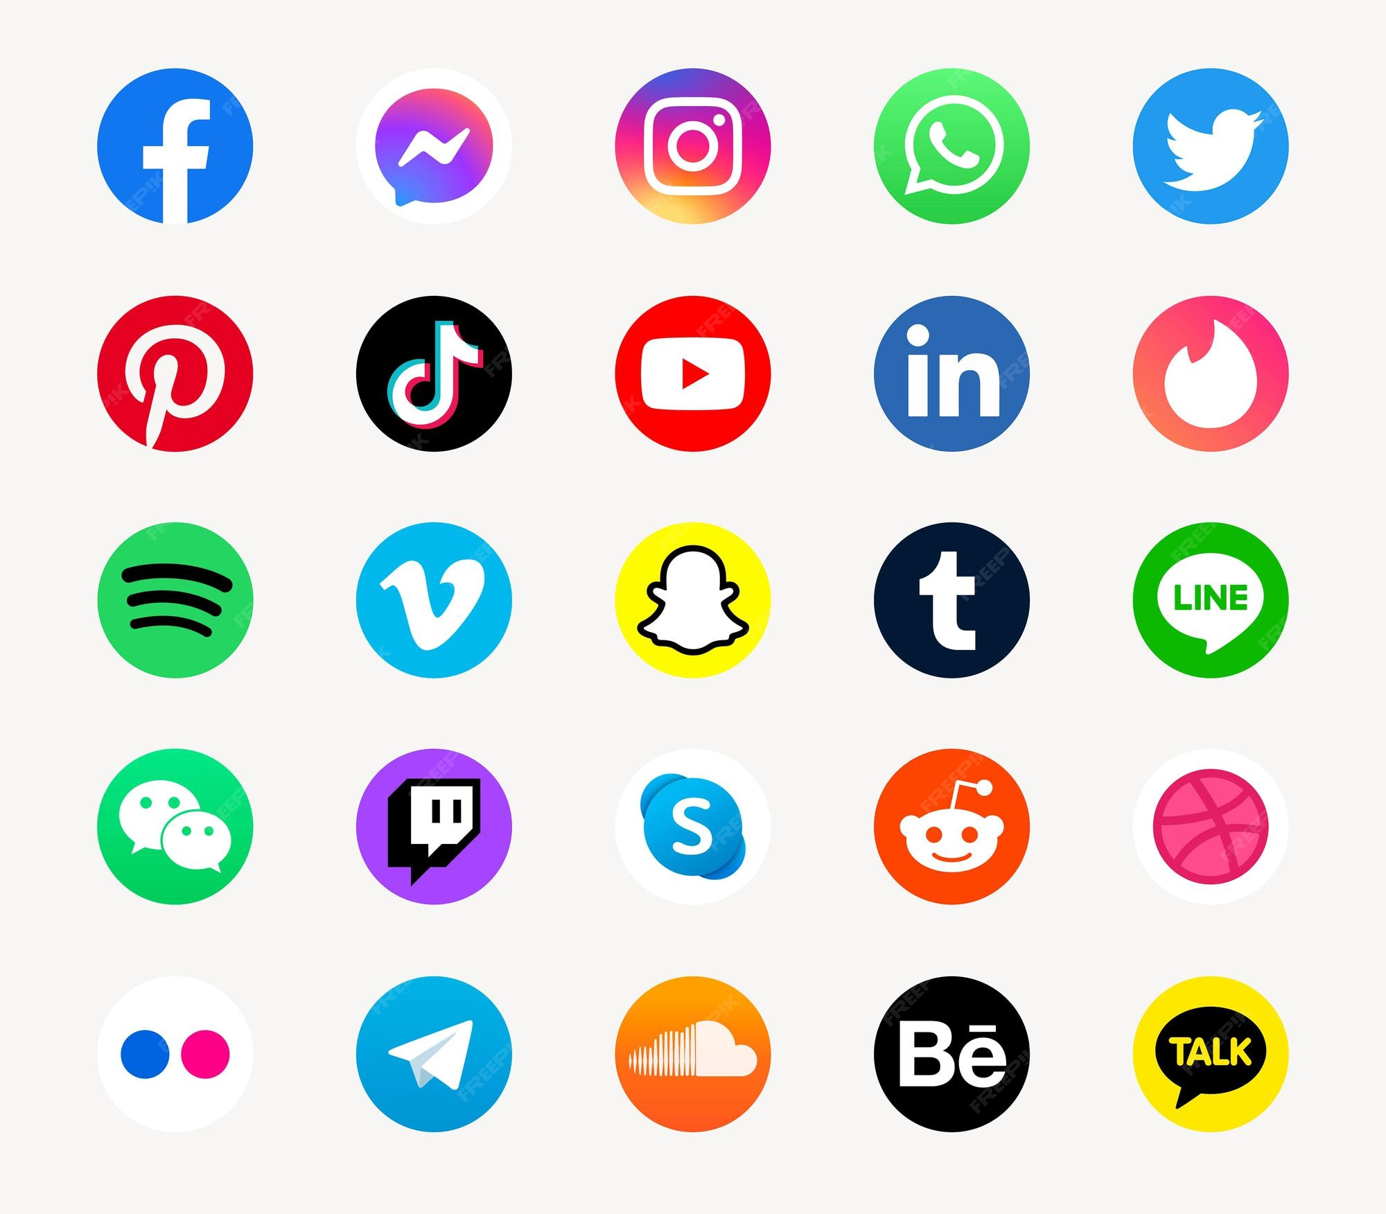
Overview
Demographics of social media
Pros/Cons of different platforms

Slide 3
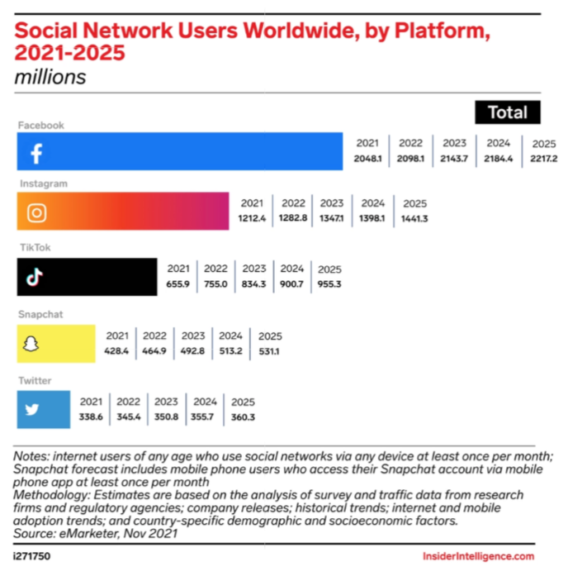

Slide 4
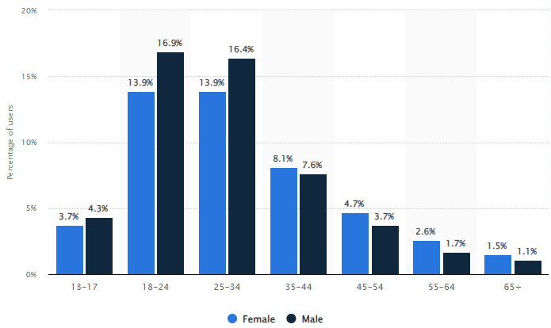
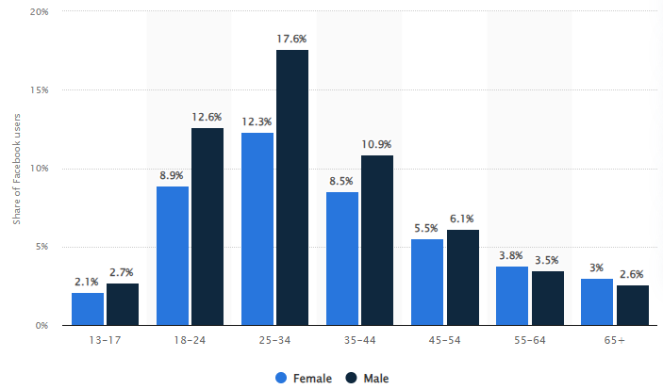
Instagram
Facebook
Distribution of Instagram/Facebook users worldwide as of January 2023, by age and gender (Statistica, 2023)

Slide 5
Instagram
Number of monthly active users: 1.35 billion
Largest age group: 18-24 (30.8%)
Time spent per day: 30.1 minutes

Slide 6
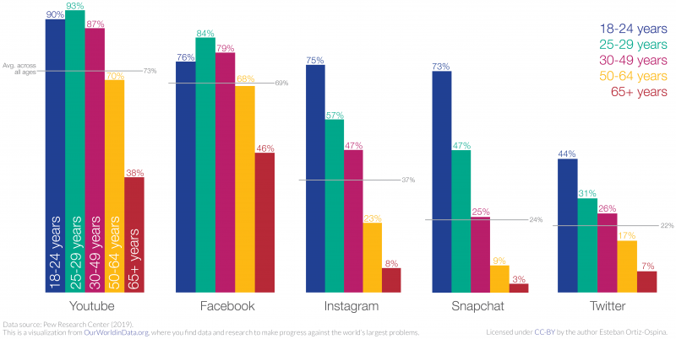

Slide 7
YouTube Videos
OBS Studio for recording
iMovie for Video Editing on a Mac
Clipchamp for Video Editing on a Windows
DaVinci Resolve for professional level editing

Slide 8
3.2 Billion Users

Slide 9
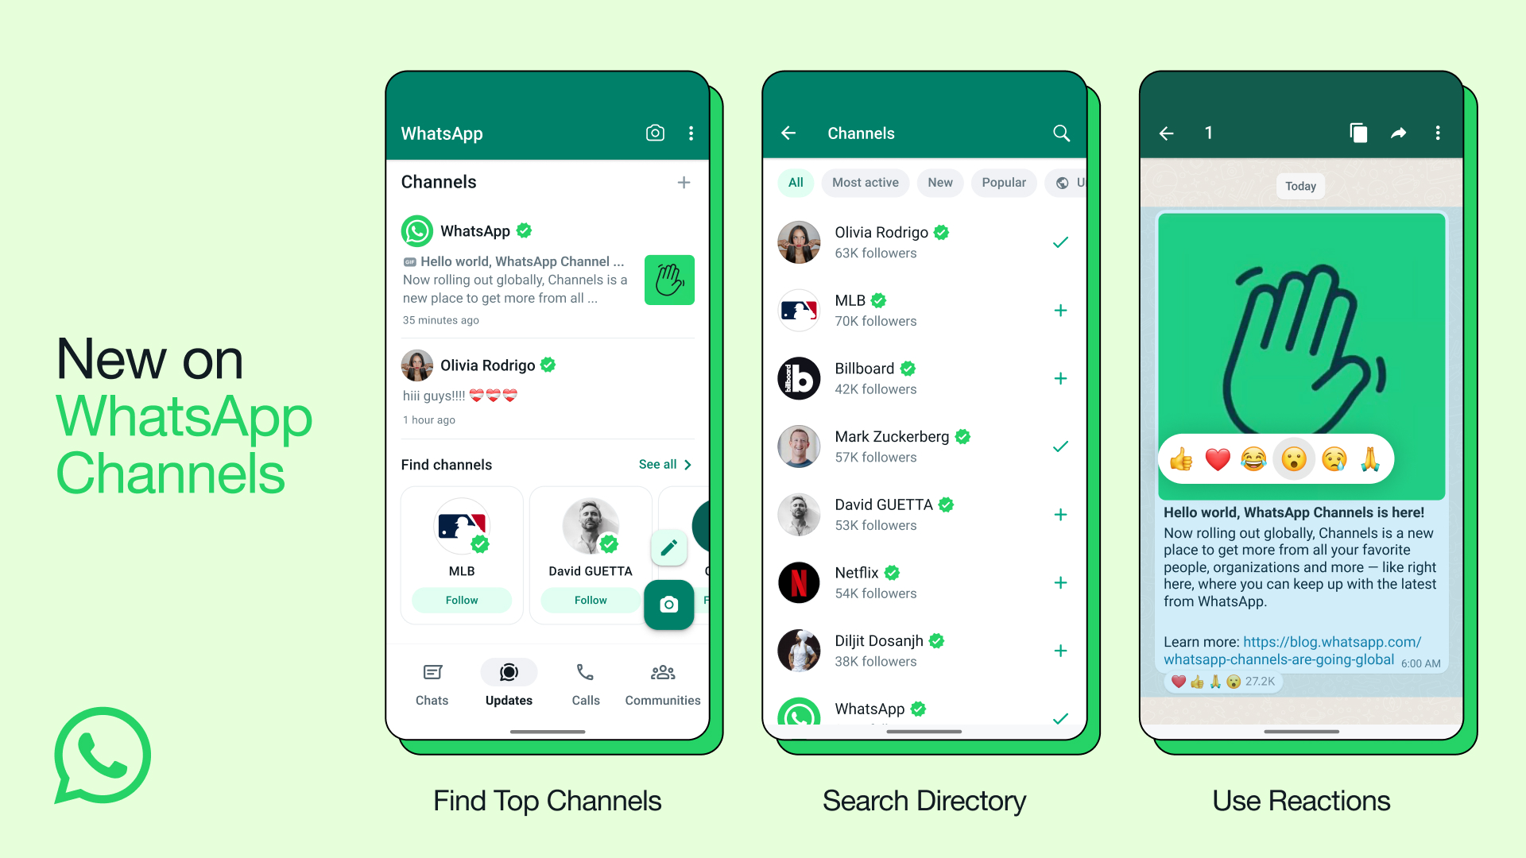
WhatsApp Channels

Slide 10
Nextdoor
Connecting neighborhoods
Great for meeting people locally

Slide 11
Closing Remarks
Facebook still a great way to reach many people
Instagram for younger audiences
YouTube for more engaging content
WhatsApp to get messages to everyone easily
Nextdoor for meeting locals

Slide 12
Thank you
Dr Sam Knox

